Slide 1
Python basics

Slide 2
Why Numpy
List is a data structure like dynamic sized heterogeneous and mutable orderd collection of items
Numpy is a array of homogeneous data types. Its features are Multidimensionality, efficient, homogeneity, Vectorization, Mathematical Operations
Numpy Array stores elements in contaguous location
id() function returns
List stores data anywhere in memory as it is of heterogeneous type
List stores reference of the location of element

Slide 3
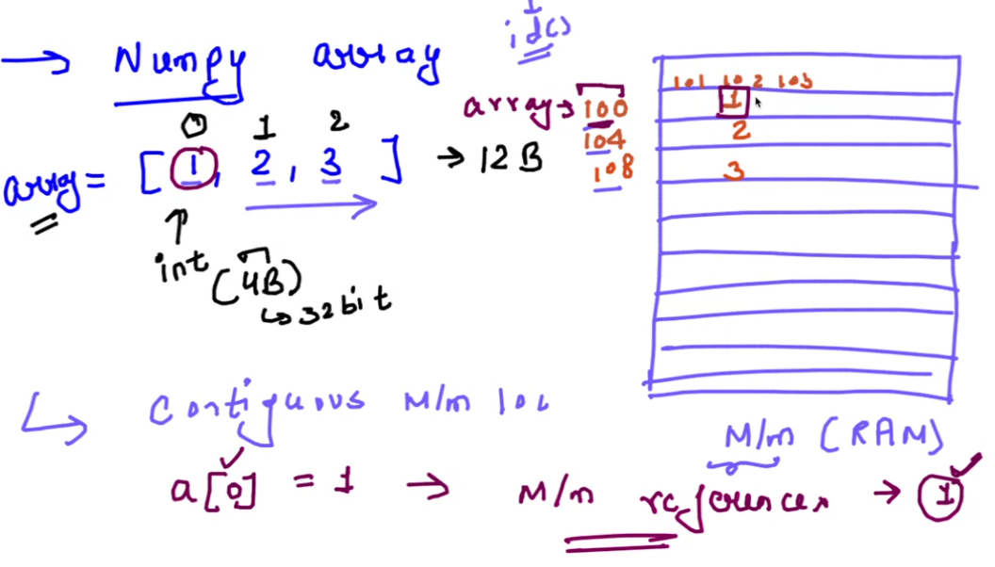


Numpy array Memory location

Slide 4
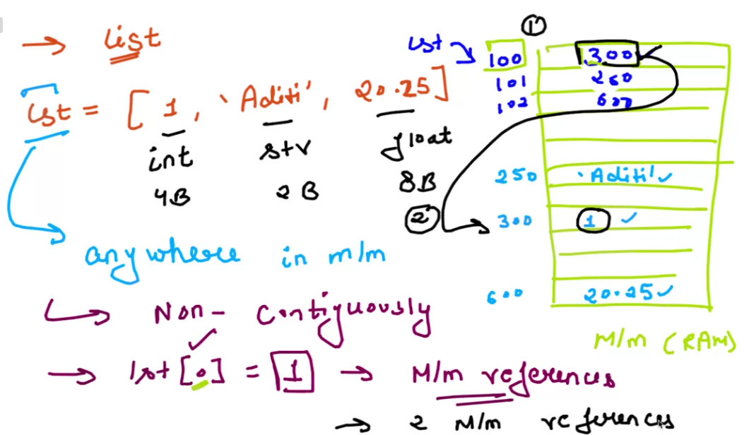


List Memory Location

Slide 5







Slide 6
id() and example of List and Numpy array
In Python, id() function is a built-in function that returns the unique identifier of an object. The identifier is an integer, which represents the memory address of the object. The id() function is commonly used to check if two variables or objects refer to the same memory location.
a=[1,2,3,4,5]
Res=[i**2 for I in a]
For list we need to manually handle using loop
np.array(a)
a
For numpy array we don’t have to handle with loop as it support vectorization and parallelization

Slide 7
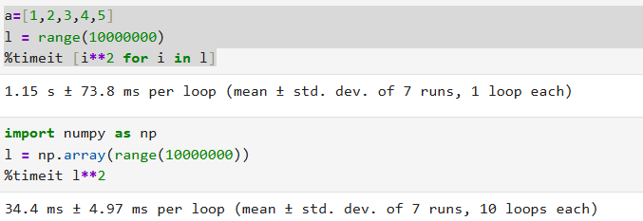
Performance comparison of list and numpy array
l = range(10000000)
%timeit [i**2 for I in a]
l_np=np.array(range(10000000)
%timeit l_np**2

Slide 8
Numpy Array
Array can be of 1-D, 2-d and n-D
Any 2-D array is collection of 2 one-D array
Ndim tells dimension
shape tells number of elements or rows and columns
np. array(range(1,10,1) -- start, end and step value
Np.arrange(1,10,.5) –creates array of float
Str >> Float >> int
arr2=np.array(1,2.0,’subham’) # everything in str type
arr5=np.array([1,2,3.0,4.5],dtype=‘int’) # all are integer
arr6=np.array([1,2,3.0,'a'],dtype='int’) #gives error
Arr6.astype(‘<type>’) converts array after creation

Slide 9
Numpy Array – indexing
Indexing starts from 0
It can go to backward direction from end – this is negative indexing
Advanced indexing
Slicing

Slide 10
Numpy 2D Array
Tabular form
Can we pass multiple array to a 2 Dimension array
We need to provide 2 lists – first list for row and second list for column : [ [ ], [ ] ]

Slide 11
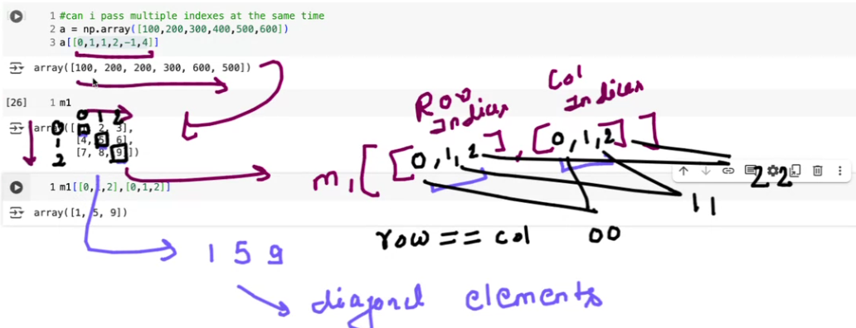

Slide 12
Slicing
It extracts sub part of the array by array[ : , : ] – for row and col extraction
m2[start row : end row , start col : end col : step]
This is really applicable in image operations – like taking a smaller portion of image
Axis direction – vertical direction as 0 and Horizontal as 1

Slide 13
Vetorization
Vectorization refers to perform operation on entire array or array elements simultaneously without using explicit loop.
It does parallel processing and optimized code at the backend and also it has more control on memory management.
Let us check in practical
Vectorizing a normal function may not improve the performance of function. Numpy Functions are written in underlyinh C Language so it is faster but not in case of normal even if we use vectorize

Slide 14
Image basics
https://colab.research.google.com/drive/1SkyA5iF7UTDR8VFhCWEy525XlcaJ8YdI#scrollTo=JkL56reWJOYy

Slide 15
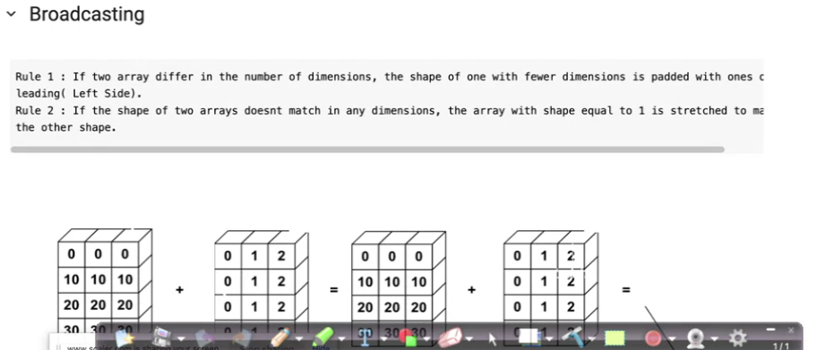
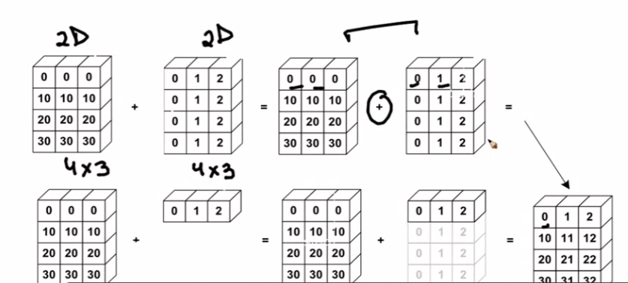
Broadcasting

Slide 16
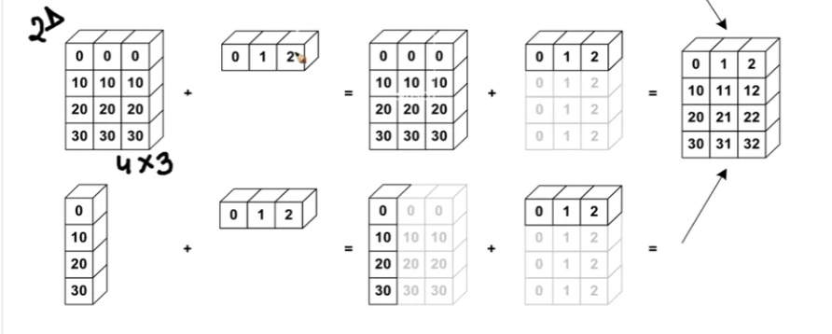

Slide 17
https://colab.research.google.com/drive/1fPBvIKVEKJhEdeWRVPCPnPmqw8CoFh9E?usp=sharing#scrollTo=DnX0gWUx-UiE

